Slide 1
Heuristic Search

Slide 2

CONTENTS
introduction
○
Hill-climbing
Best-first search algorithm


Using heuristics in games
The end


Slide 3
introduction
○
Heuristics search
Notes:
Our team has:
Nguyễn Thanh Xuân Tùng
Huỳnh Thị Yến Nhí
Nguyễn Trương Đạt
Nguyễn Thị Thu Xuyên

Slide 4
HEURISTICS
UK: /hjʊəˈrɪs.tɪk/ US: /hju:ˈrɪs.tɪk/
Is a method to solve a problem, not guaranteed to be optimal, perfect, logical, or rational, but fast for reaching an immediate goal.
Is familiar to our daily life.
For example:
Faced with a lunch menu with too many options without prepared? → opt for what you’ve enjoyed in the past.
Finding path to new location based on path you have discovered before.
Choose a chapter which most important and easy on recent examination’s question to study first.
This presentation will not be a “best” that makes you master the Heuristics but “good” to makes you understand it quickly.
Notes:
https://en.wikipedia.org/wiki/Heuristic
https://dictionary.cambridge.org/vi/dictionary/english/heuristic

Slide 5
HEURISTICS SEARCH in computer science
Is a method that
  might not always find the best solution.
  but is guaranteed to find a good solution in reasonable time (cost).
By sacrificing completeness it increases efficiency.
Useful in solving tough problems which
  could not be solved any other way.
  solutions take an infinite time or very long time to compute.
Notes:
https://en.wikipedia.org/wiki/Heuristic_(computer_science)

Slide 6
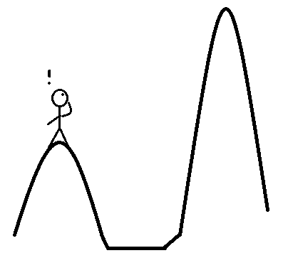
Hill-climbing method and dynamic programming
Heuristics search
Notes:
https://en.wikipedia.org/wiki/Hill_climbing

Slide 7
“Hill-climbing” method?
Hill-climbing is a mathematical optimization technique:
Belongs to the family of local search.
Is an iterative algorithm that ..
How to:
Starts with an arbitrary solution to a problem, make a change then:
Repeat: [If the change produces a better solution, another incremental change is made to the new solution]
Until : No further improvements can be found
Got a “good” solution
For Example:
“Solve” function in Casio Calculator

Slide 8
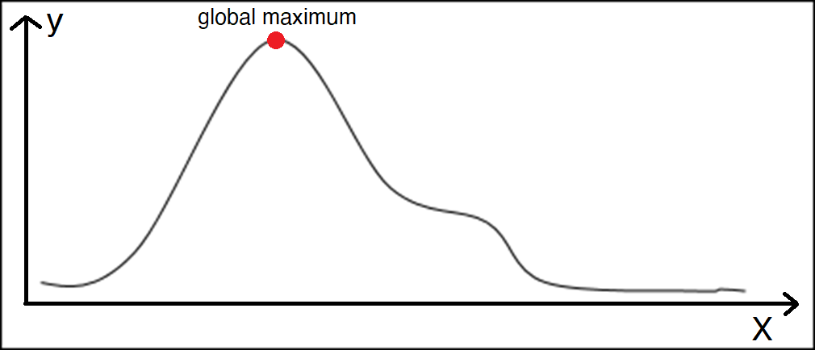
Let’s give a try
Start with an arbitrary solution, make an incremental change
Repeat: [If the change produces a better solution, make another incremental change to the new solution]
Until : No further improvements can be found
Got a “good” solution, but..

Slide 9
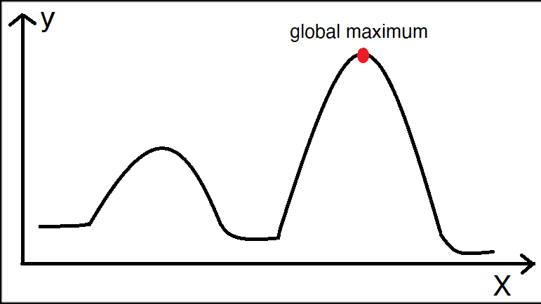
Problem #1
Local maxima problem: At a local maximum, all neighboring states have a values which is worse than the current state but still not as best as global maximum.
Solve:
Backtracking technique: Maintain a list of visited states. If the search reaches an undesirable state, it can backtrack to the previous configuration and explore a new path.
Random walk.
Local maximum
Notes:
https://www.geeksforgeeks.org/introduction-hill-climbing-artificial-intelligence/

Slide 10
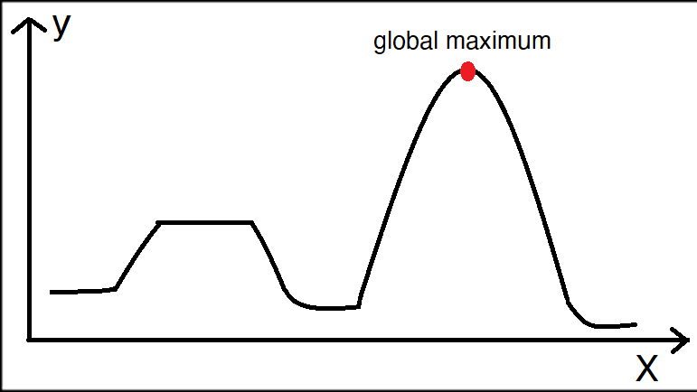
Problem #2
Plateau problem: On plateau all neighbors have same value. Hence, it is not possible to select the best direction.
Solve:
Make a big jump.
Randomly select a state far away from current state.
Chances are that we will land at a non-plateau region
Local plateau maximum
Notes:
https://www.geeksforgeeks.org/introduction-hill-climbing-artificial-intelligence/

Slide 11
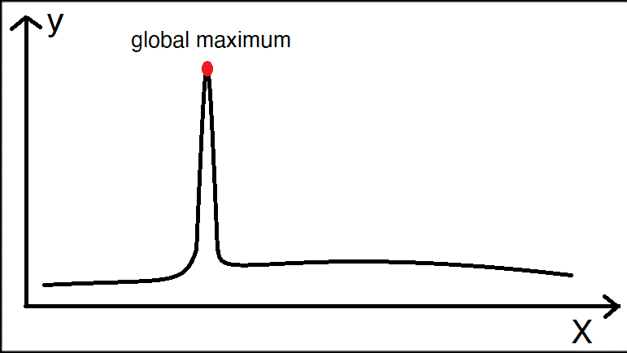
Problem #3
Ridge problem: Any point on a ridge can look like peak because movement in all possible directions is downward. Hence the algorithm stops when it reaches this state.
Solve:
Improve incremental change function (make a smaller step, using rate of change, etc.)
Notes:
https://www.geeksforgeeks.org/introduction-hill-climbing-artificial-intelligence/

Slide 12
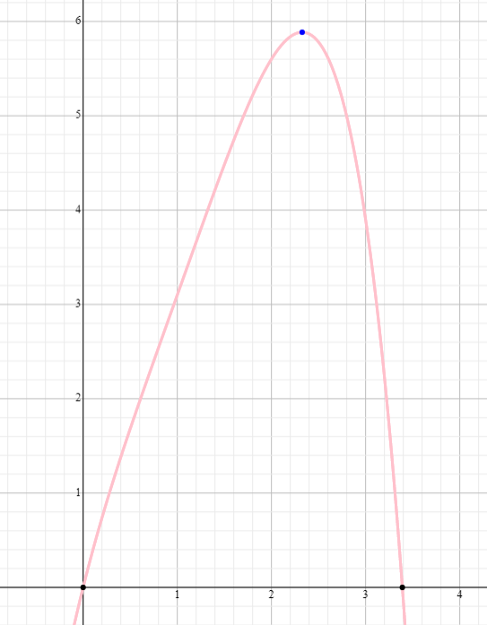
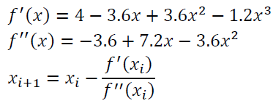
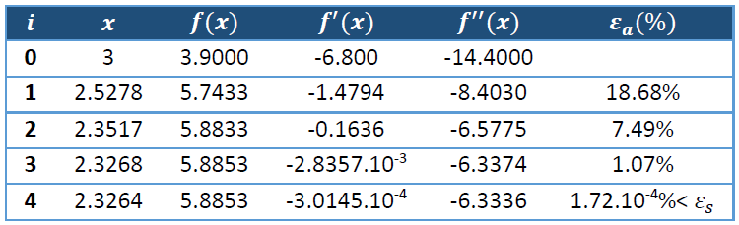
example
Notes:
Take from Mr Synh quiz!

Slide 13
Dynamic programming
Hill-climbing is a mathematical optimization technique:
Belongs to the family of local search.
Is an iterative algorithm that ..
How to:
Starts with an arbitrary solution to a problem, make a change then:
Repeat: [If the change produces a better solution, another incremental change is made to the new solution]
Until : No further improvements can be found
Got a “good” solution
For Example:
“Solve” function in Casio Calculator

Slide 14
Best-first search algorithm

Heuristics search
Breadth-first search algorithm
Notes:
https://www.geeksforgeeks.org/best-first-search-informed-search/
https://www.youtube.com/watch?v=iGEu2wab8y0

Slide 15
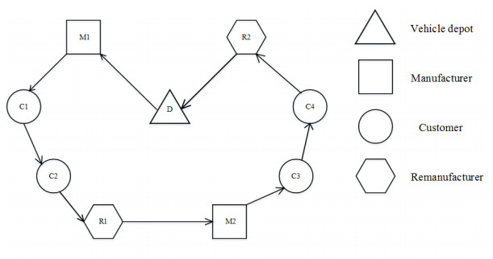
BEST-FIRST?
Simple: choose what seem to be most “best” first.
Example:
  Do the most valuable question first in examination.
  Ship the package which has nearest location first.

Slide 16
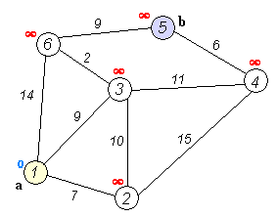
Review Dijkstra
$$d\left(u\right)=min⁡\{d\left(v\right)+w\left(v,u\right), v ∈X^{−}\left(u\right)\}$$

Slide 17
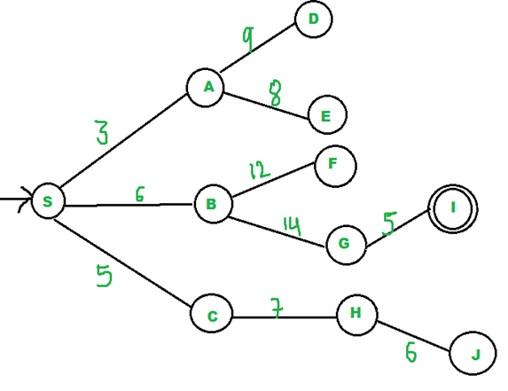
BEST-FIRST search
Is a search algorithm which explores a graph by expanding the most promising node chosen according to a specified rule.

Slide 18
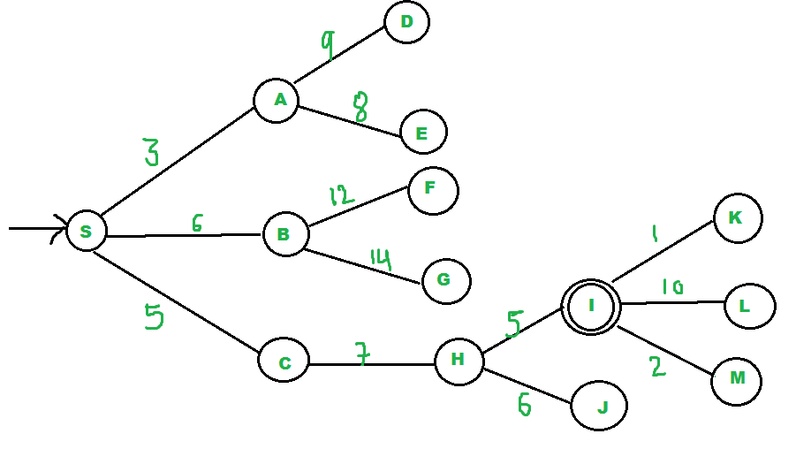
BEST-FIRST search
Example:
This is a tree.
Find the path from S to I.
Low discovery cost is required!
Using Best-first Search.

Slide 19
example
#Pseudocode:
open = []; closed=[]; goal = I
evaluate(node):
if (node is not goal):
open.delete(node);
closed.sortAdd(node);
open.sortAdd(node.getChildList());
for (Node childNode in open):
evaluate(childNode);
else:
“Found it”
>> evaluate(s)

Slide 20
example
open = [], closed = []
evaluate(S0), open = [A3, C5, B6],
closed = [S0]
evaluate(A3), open = [C5, B6 E8, D9],
closed = [S0, A3]
evaluate(C5), open = [B6, H7, E8, D9],
closed = [S0, A3, C5]
evaluate(B6), open = [H7, E8, D9, F12, G14],
closed = [S0, A3, C5, B6]
evaluate(H7), open = [I5, E8, D9, F12, G14],
closed = [S0, A3, C5, B6. H7]
evaluate(I5), the solution is found!

Slide 21
What if?
→ Fall into worst case

Slide 22

Another Example - Greedy algorithm
Example:
An ATM has:
- 5 banknotes of 20$, 2 banknotes of 10$, 2 banknotes of 5$ and 3 banknotes of 2$.
Require: Withdraw 35$ with minimum banknotes!

Slide 23
Another Example - Greedy algorithm
Solution with greedy:
- Remain 35$
- Withdraw 35 % 20 = 1 (banknote of 20$), remain 15
- Withdraw 15 % 10 = 1 (banknote of 10$), remain 5
- Withdraw 5 % 5 = 1 (banknote of 5$), remain 0 (Done)
Result: Withdraw 1 – 20$, 1 – 10$, 1 – 5$
HOW ABOUT 36$?

Slide 24
Using heuristics in game

Heuristics search

Slide 25
MINIMAX (MINMAX OR MM)
Is a decision rule used in artificial intelligence, decision theory, game theory…
  For minimizing the possible loss for a maximum loss scenario. When dealing with gains, it is referred to as "maximin"—to maximize the minimum gain..
  Originally formulated for two-player zero-sum game theory
Notes:
https://en.wikipedia.org/wiki/Minimax
https://viblo.asia/p/thuat-toan-minimax-ai-trong-game-APqzeaVVzVe

Slide 26
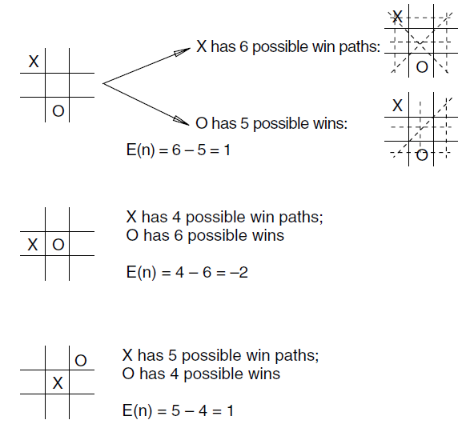
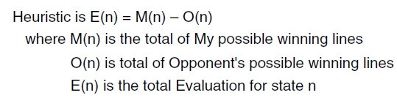
Minimax in tic-tac-toe
Notes:
https://en.wikipedia.org/wiki/Minimax
https://viblo.asia/p/thuat-toan-minimax-ai-trong-game-APqzeaVVzVe

Slide 27
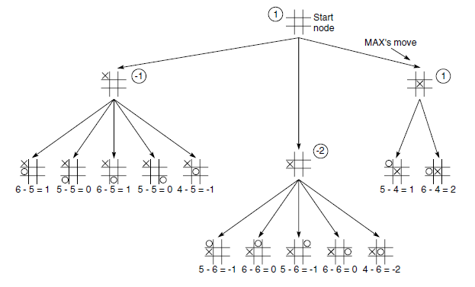
Minimax in tic-tac-toe
Notes:
https://en.wikipedia.org/wiki/Minimax
https://viblo.asia/p/thuat-toan-minimax-ai-trong-game-APqzeaVVzVe
https://medium.freecodecamp.org/simple-chess-ai-step-by-step-1d55a9266977

Slide 28
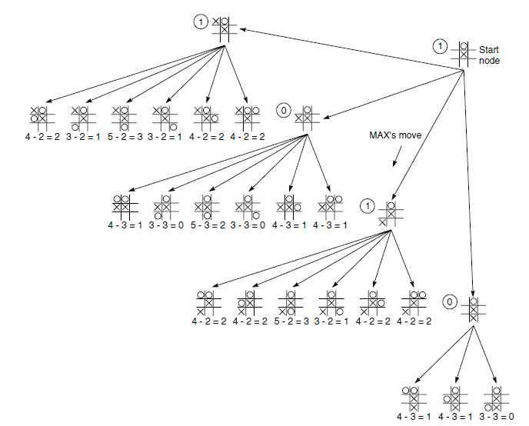
Minimax in tic-tac-toe
Notes:
https://en.wikipedia.org/wiki/Minimax
https://viblo.asia/p/thuat-toan-minimax-ai-trong-game-APqzeaVVzVe
https://medium.freecodecamp.org/simple-chess-ai-step-by-step-1d55a9266977

Slide 29
The end

Heuristics search

Slide 30
AFTER CLASS
Try making a simple chess AI:
https://medium.freecodecamp.org/simple-chess-ai-step-by-step-1d55a9266977
Notes:
https://en.wikipedia.org/wiki/Minimax
https://viblo.asia/p/thuat-toan-minimax-ai-trong-game-APqzeaVVzVe
https://medium.freecodecamp.org/simple-chess-ai-step-by-step-1d55a9266977

